Slide 1
DNS/AD

Slide 2
DNS
Domain Name System
Provides domain name and IP address translation

Slide 3
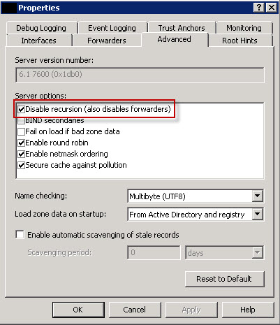
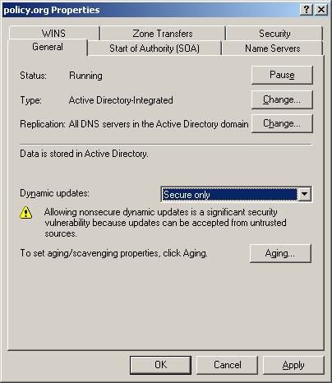
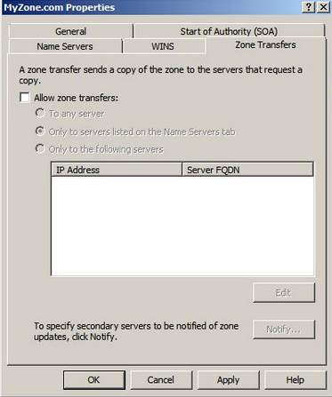
dnsmgmt.msc
For your server
Disable recursion*
For your zone
Do not allow nonsecure dynamic updates
Disable/limit zone transfers
*Depends on company policy
Notes:
*Disabling recursion also disables internal-to-Internet network communications
Your computer is not affected

Slide 4
AD
Active Directory
Provides domain structure, organization, and authentication

Slide 5
New run commands
DON’T USE LUSRMGR.MSC
Use dsa.msc
Configure users like you normally do (account options in Account tab)
Make sure to check ALL admin groups for non-admins
gpmc.msc
Has priority over gpedit.msc and secpol.msc
Delete links, create new GPO, import your own into it, link the GPO so it affects your computer, force update for immediate effect

